Slide 1
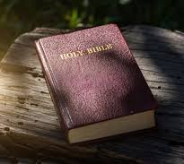
The Bible

Slide 2
Good Interpretation (2 Parts)
Exegesis
“careful, systematic study of the Scriptures to discover the original, intended meaning”
What the text meant!
Hermeneutics
“seeking the contemporary relevance of ancient texts”
What the text means!
Importance of above: rule out improbable interp/reminds us about presuppositions we bring to the text. (Biblical cross not t, but T)

Slide 3
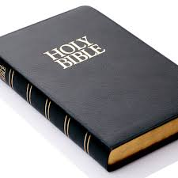
Where do we Start?

Slide 4
The Bible: its authors and message
Collection of Books (73 for Catholics; 66 for Protestants) written over 1500 years by over 30 human authors, all of whom were influenced and inspired by the Holy Spirit.
Original Languages – Hebrew and Aramaic (OT), Greek (NT)
בְּרֵאשִׁית, בָּרָא אֱלֹהִים, אֵת הַשָּׁמַיִם, וְאֵת הָאָרֶץ - Genesis 1:1
ἐν ἀρχῇ ἦν ὁ λόγος, καὶ ὁ λόγος ἦν πρὸς τὸν θεόν, καὶ θεὸς ἦν ὁ λόγος. - John 1:1
Biblical Message in Three Words
Creation
Fall
Redemption
Biblical Message in Three Sentences (Dan Barbera)
God Made it.
We Broke it.
Jesus Fixes it.

Slide 5
The Different Parts of the Bible
Hebrew Bible (OT) - TaNaKh
New Testament
Ta = Torah (Law)
Genesis, Exodus, Leviticus, Numbers, Deuteronomy
Na = Nebiim (Prophets)
Former – Joshua, Judges, 1 and 2 Samuel, 1 and 2 Kings
Latter – Isaiah, Jeremiah, Ezekiel, Book of 12
Kh = Khetubim (Writings)
Psalms, Proverbs, Job, Song of Solomon, Ruth, Lamentations, Ecclesiastes, Esther, Daniel, Ezra, Nehemiah, 1 and 2 Chronicles
Gospels
Matthew, Mark, Luke, John
History
Acts
Epistles
Romans, 1 and 2 Corinthians, Galatians, Ephesians, Philippians, Colossians, 1 and 2 Thessalonians, 1 and 2 Timothy, Titus, Philemon, Hebrews, James, 1 and 2 Peter, 1-3 John, Jude
Apocalypse
Revelation

Slide 6
Examples of Different Genres
Don’t walk on the grass.
Dear Patrick, Attached are two tickets to the Bucks Game, one for you and one for Kevin Morill.
Sincerely,
Giannis
“A long way out in the deep blue sea there lived a fish. Not just an ordinary fish, but the most beautiful fish in the entire ocean.”

Slide 7
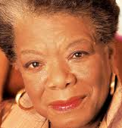
Examples of Different Genres (Cont.)
You may write me down in history
With your bitter, twisted lies,
You may tread me in the very dirt
But still, like dust, I’ll rise

Slide 8
The Bible contains different genres.
Narratives
stories illustrating what God is doing to or through people
Law(s)
Standards given by God to regulate His people. One followed these laws not to become a member of God’s community but as a response of gratitude to God’s act of redemption/deliverance.
Prophetic Literature
Enforced God’s Covenant by reminding about blessings/curses of the Law.
Gospels
Books about the life and teaching of Jesus. Crucial to understanding the gospels is a familiarity with the kingdom of God that Jesus’ ministry brings about.
Parables
“told to address and capture the hearers, to bring them up short about their own actions, or to cause them to respond in some way to Jesus and His ministry”
Psalms
Songs/prayers expressing the whole range of human emotions to God.

Slide 9
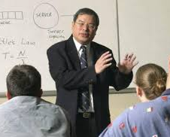
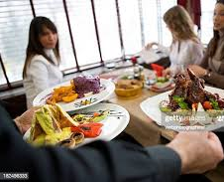
Context Matters!!!
“I Love this course!”

Slide 10
Biblical Contexts
Historical Context
Time/culture of author and readers – political, geographical, etc.
Occasion – why text is written/problems being addressed
Literary Context
Consideration of text in relation to what comes before and after.
Question to ask – What is main point? What comes next? Why?
Tools
Bible dictionaries, bible handbooks, biblical commentaries, study Bibles

Slide 11
Steps to take in Interpretation
Read
If possible, read book in one or two sittings. (Consider reading aloud)
Jot down notes that help you understand occasion and context.
Determine
Determine the genre or genres included in the work to decide how various portions are functioning.
Consult
Consult various sources where appropriate.
Pray
Critical.
Consider
Consider the Bible as a source not just of information, but of formation – an encounter with God through the text.

Slide 12
Occasion of 1 Timothy
Sender (Paul) to Recipient (Timothy) located in __________
Info on Paul (1:12-14; 2:14)
Info on Timothy (1:2; 1:18; 4:12)
Info on Ephesian Church
Occasion
False teaching is threatening church (1:6; 1:19; 4:1; 5:15; 6:10; 6:20)
Timothy is a young man with temporary oversight of the church at Ephesus who must preserve the sound teaching he had received and heard preached by his father in the faith (Paul).

