Slide 1
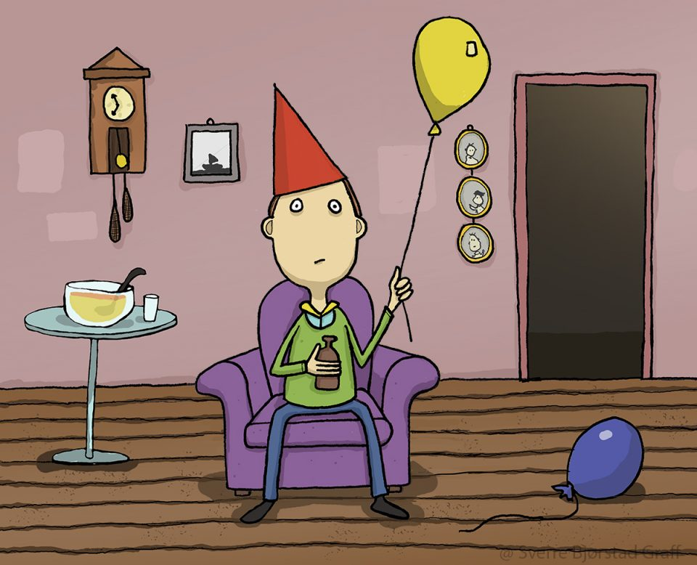

Slide 2
Acts 7:51-53
Then Stephen said, “You stubborn Jewish leaders! You refuse to give your hearts to God or even listen to him. You are always against what the Holy Spirit wants you to do. That’s how your ancestors were, and you are just like them! ⁵² They persecuted every prophet who ever lived. They even killed those who long ago said that the Righteous One would come. And now you have turned against that Righteous One and killed him. ⁵³ You are the people who received God’s law, which he gave you through his angels. But you don’t obey it!”

Slide 3
2 Corinthians 4:3-4
The Good News that we tell people may be hidden, but it is hidden only to those who are lost. ⁴ The ruler of this world has blinded the minds of those who don’t believe. They cannot see the light of the Good News—the message about the divine greatness of Christ. Christ is the one who is exactly like God.

Slide 4
1 Peter 2:9
You are his chosen people, the King’s priests. You are a holy nation, people who belong to God. He chose you to tell about the wonderful things he has done. He brought you out of the darkness of sin into his wonderful light.

Slide 5
Isaiah 25:6-9
⁶ The Lord All-Powerful will give a feast for all the people on this mountain. At the feast, there will be the best foods and wines. The meat will be good and tender, the wine pure and clear.
⁷ But now there is a veil covering all nations and people. This veil is called “death.” ⁸ But death will be destroyed forever. And the Lord God will wipe away every tear from every face. In the past, all of his people were sad, but God will take away that sadness from the earth. All of this will happen because the Lord said it would.

